Slide 1
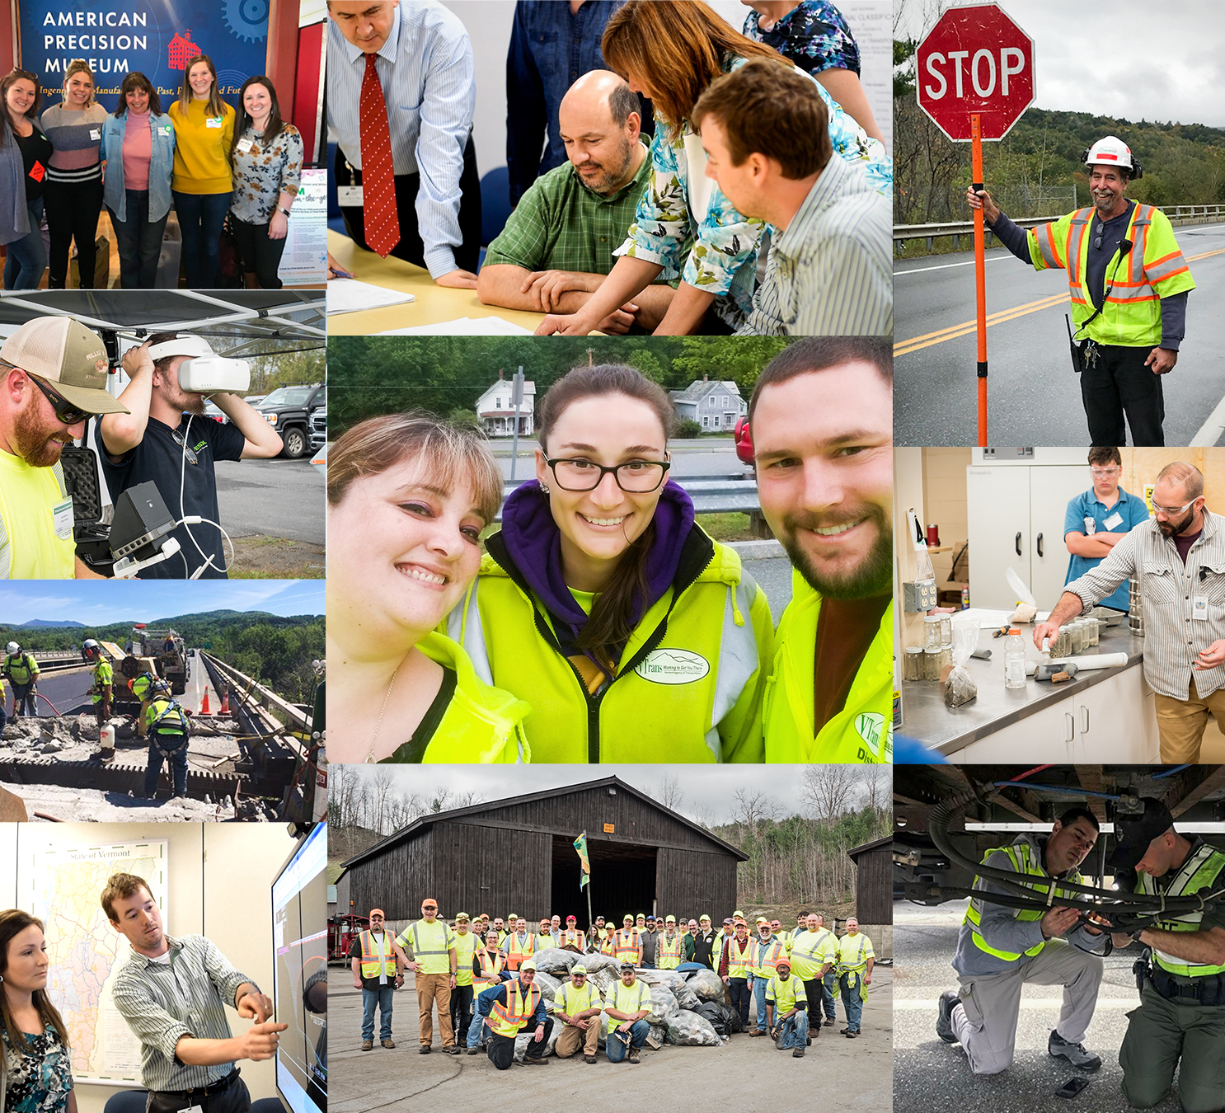
Strategic Workforce Management Best Practices
Domestic Scan 19-02,
October 26-20, 2020
Christine Hetzel, Director of organizational development Vermont Agency of Transportation

Slide 2
Vermont Agency of Transportation
Who Are We?
It Takes a Village to Embark on Strategic Workforce Management
Vermont AOT, Strategic Workforce Plan
VTrans Training Center Programs & Partnerships
COVID-19, The Change Accelerator
VTTC Tools
Notes:
Won’t be discussing talent acquisition and much on diversity and inclusion since Lori V presented an extensive amount of information in San Diego. Happy to share her presentation with those that could not make it.

Slide 3
Who Are We?

Slide 4
In This Section
Org Charts & Quick Facts
Mission, Vision, Core Values
VTTC-Civil Rights-HR Partnership

Slide 5
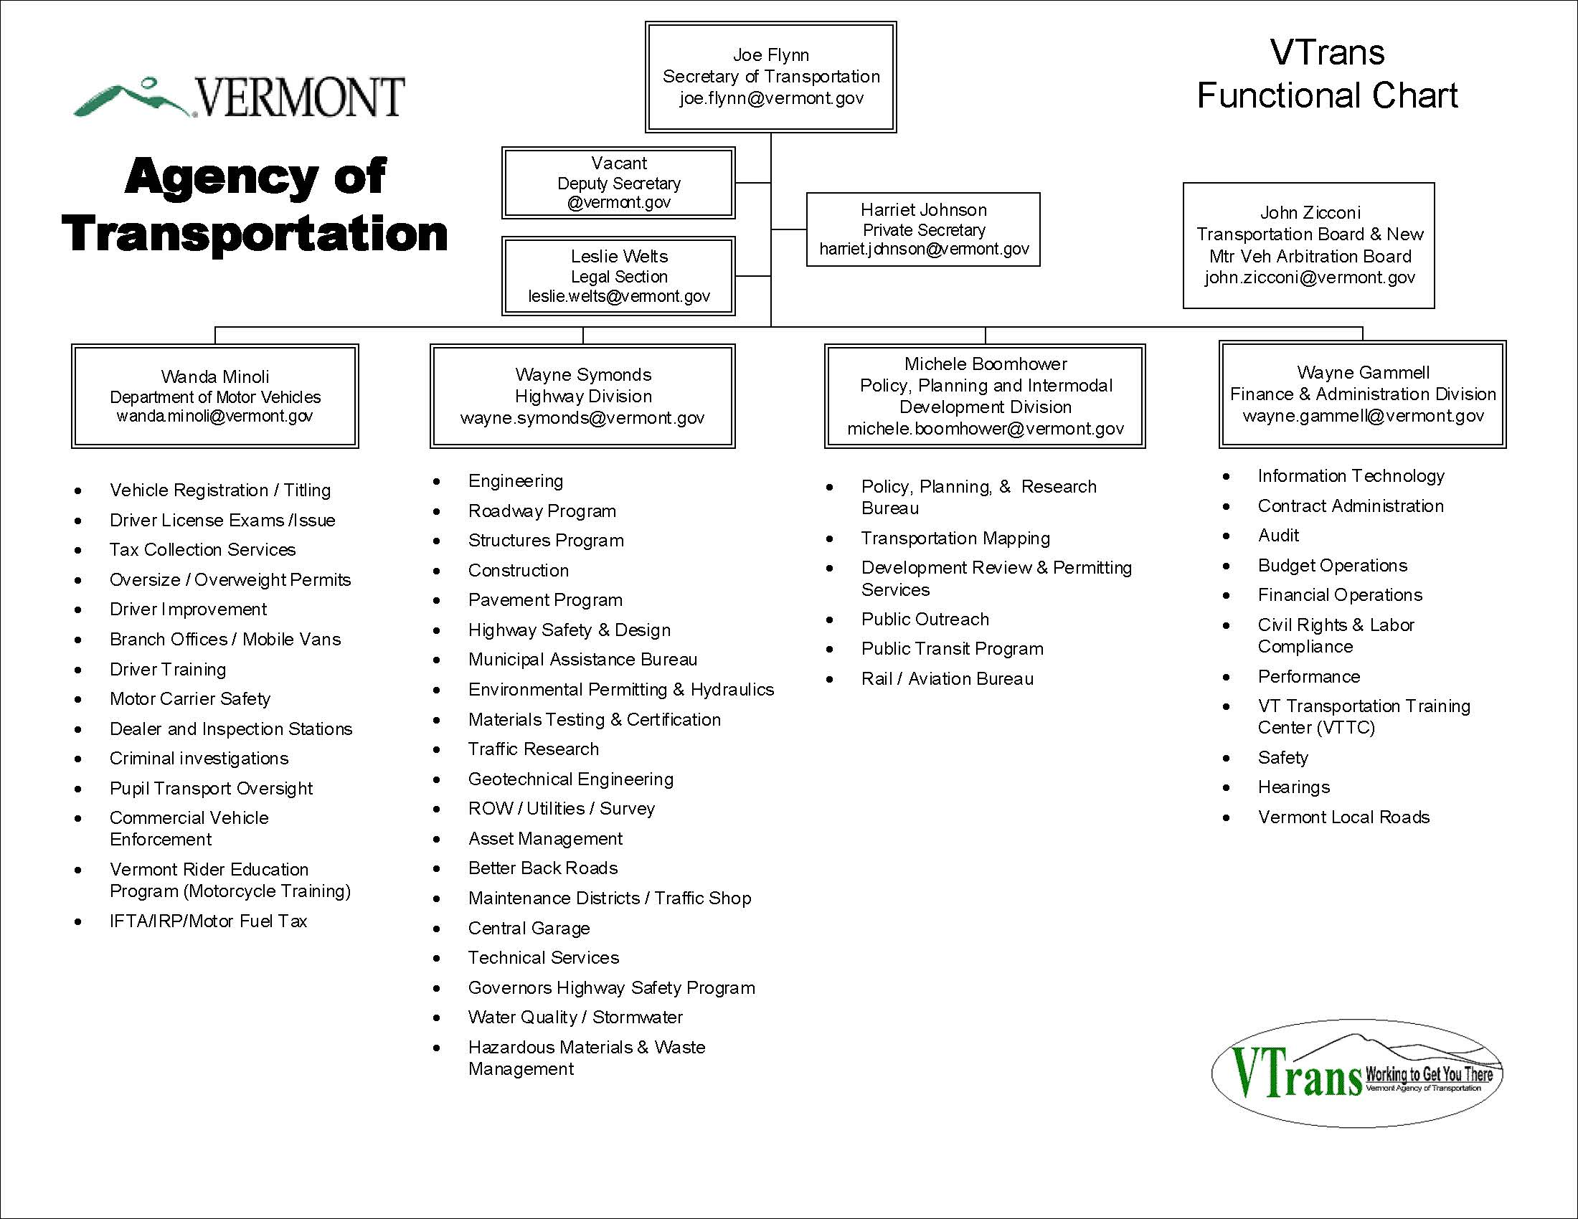

Slide 6
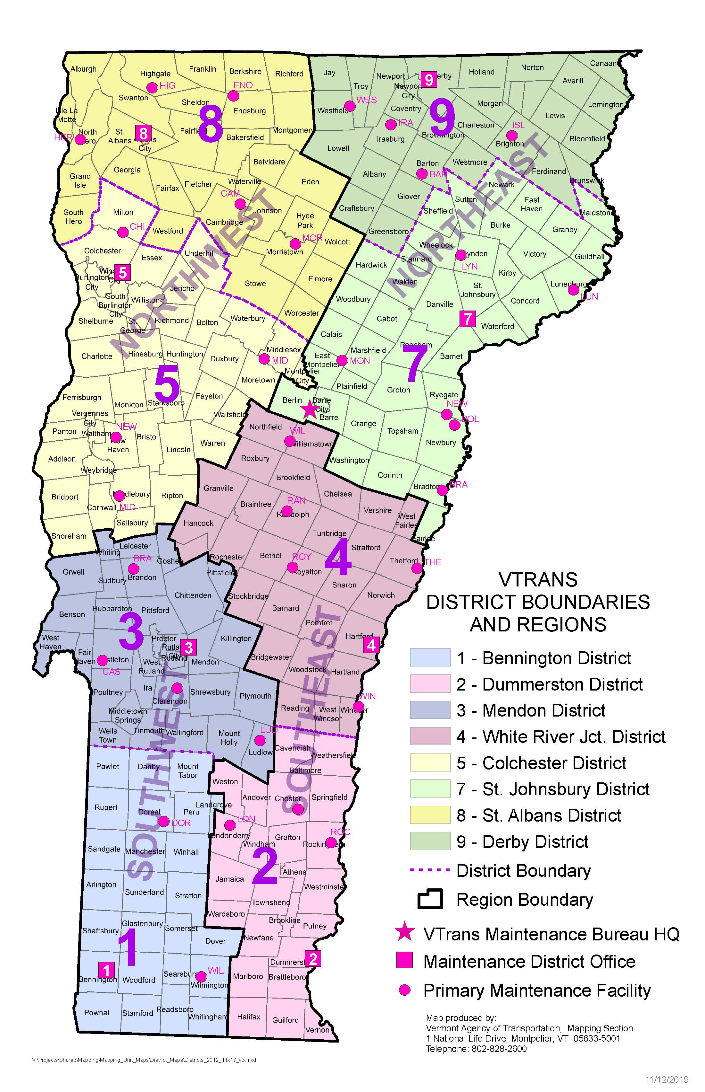
Districts and Regions

Slide 7
Quick Facts
1271 Employees
Second Largest Vermont State Agency
Multimodal & Department of Motor Vehicles
8 Maintenance Districts
10 State Airports
11 DMV Locations
95 Projects Under Construction
2.6 Million Lane Miles Plowed
600 Miles of Rail
208 Miles Paved
96 Facilities
7

Slide 8
Mission, Vision, & Strategic Goals
MISSION Through excellent customer service, provide for the safe and efficient movement of people and goods.
VISION A safe, reliable, and multimodal transportation system that grows the economy, is affordable to use and operate, and serves vulnerable populations.
STRATEGIC GOALS Promote organizational excellence by attracting, developing, and retaining a talented, diverse, and engaged workforce.
Grow Vermont’s economy by providing a safe, reliable, and efficient transportation system in a state of good repair.
Make Vermont more affordable and serve the vulnerable by providing accessible, convenient, and affordable travel choices.
Transition to an energy efficient, advanced technology transportation system.
Modernize and improve government efficiency through innovation, continuous improvement, and quality customer service.
8

Slide 9
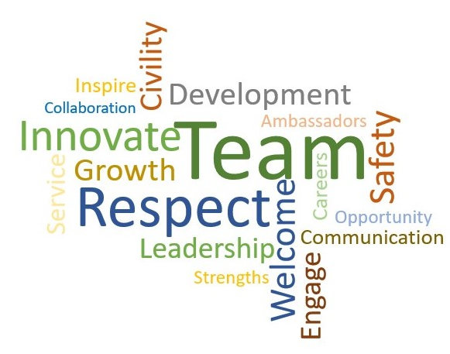
Core Values

Slide 10
Shared Human Resources Activities
Department of Human Resources Responsibilities
All transactional HR Work
Owner of Talent Acquisition System
Owner of Position, Classification, and Compensation System
Centralized services provided with DHR field staff assigned to all Agencies
Implement bargaining and manage bargaining agreements
Manage Benefits program
Manage disciplinary process
Civil Rights Responsibilities
Oversee federally mandated EEO and non-discrimination programs, DBE, OJT and Davis-Bacon
Oversight, compliance and enforcement responsibilities
Talent acquisition, outreach, recruitment and hiring
Orchestrator of new employee onboarding
Workplace civility policies, practices and training
Emphasis on youth outreach, training and employment initiatives
Contractor Compliance

Slide 11
Shared Human Resources Activities with the VTrans Training Center
Shared responsibilities for New Employee Welcome
Coordination of all training opportunities to include leadership, development, technical and safety training
Manage Occupational Health and Safety Program
Collaboration with Central DHR training and other Agencies
Maintain Learning Management System in conjunction with other Agencies
Build unique training programs for AOT
Manage the VT Local Technical Assistance Program (LTAP) = Vermont Local Roads
Oversee Agency employee retention strategies
11

Slide 12
It Takes a Village to Embark on Strategic Workforce Management

Slide 13
In This Section
Peer Exchange
States We’ve Collaborated With

Slide 14
Peer Exchange with Alaska DOT
Collaboration began in Kansas City, 2018 AASHTO Agency of Admin Conference
6/2018, 2- week visit, Juneau, Anchorage, and Fairbanks, two employees
Met with Human Resources
Met with LTAP Partners
Met with Key Leaders
Toured Districts
Met with LTAP Leaders
Mentorship
Sharing materials
Brainstorming
Accountability
10/2018, 1- week visit Alaska DOT to VT DOT, 3 employees

Slide 15
Peer Exchange with Alaska DOT – Information Sharing Topics
Workforce planning and management
Recruitment strategy review
Transportation awareness programming for future employees (university, tech schools)
Results based alignment
Leadership and learning programs
Knowledge management programming
Highway Safety
Occupational health and safety
Met with local leadership consultant
Reviewed contract administration processes
Reviewed budgeting and performance measurement
Maintenance operations; South, Central and Northern
Employee onboarding; Human Resources and department specific
DMV meeting to discuss best practices and appointment management
Reviewed employee recognition programs
Received drone program overview
Shared technical training resources (LTAP)
Reviewed Transportation Academy content
Met with Executives to discuss collaboration opportunities
Attended permafrost tour
Aviation program review and tour of the Alaska International Airport
IT consolidation and recruiting best practices

Slide 16
Peer Exchange Outcome Examples
Completion of AOT Strategic Workforce Report
Joint creation of AK/VT Lock Out, Tag Out safety program
Inclusion of performance metrics included in VLR Roads Pavement and VLR Roads Signage Courses.
Information regarding Infant at Work program implemented (shared from Washington)
Example of employee entrance survey leverage to create "stay interview" tool for supervisor toolkit
Knowledge management programming created for Transportation Leadership Institute Accountability
Engineering series competency matrix shared to develop JDP
VTTC website updated
Use of case study in Transportation Leadership Institute
Framework for VT to develop employee recognition programming - ongoing
Information leveraged to develop VT Drone Program
Many, many examples of cost savings realized.
How do we share more information with each other?

Slide 17
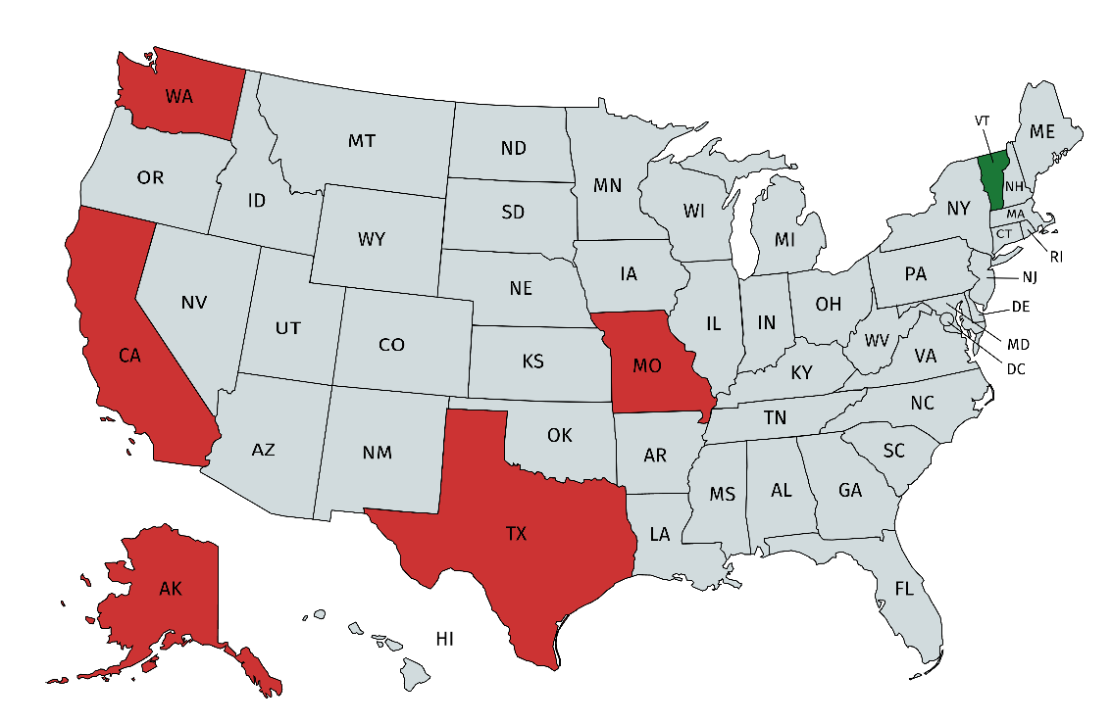
Comparing Other Strategic Workforce Reports - DOT’s
Alaska
California
Washington
Texas
Missouri
17

Slide 18
Vermont, Strategic Workforce Plan

Slide 19
In This Section
Workforce Trends
Strategic Goal Objectives
Cultural Priorities & Focus Areas
Workforce Committees
Future Initiatives

Slide 20
Strategic Workforce Plan; What we Needed to Consider

Slide 21
Critical Workforce Trends
Employee flexibility in working conditions/schedules/work life integration
Leaner employee counts, higher service expectations with fewer resources
Upskilling and development of career paths
Retention issues
High retirement rates and aging workforce
Multiple generations in the workplace
Difficulty finding qualified candidates – younger demographics – general laborers and jobs that require round the clock coverage during snowstorms and construction
Attracting and retaining a diverse workforce – double the turnover rate for people of color and women (especially in the maintenance job classifications)
Supervisors are seeking voluntary demotions

Slide 22
Additional Workforce Considerations
Pre COVID-10 incredibly low unemployment rate 3.2%
Vermont government has three active non-striking unions
Government positions are managed by the Legislature
Workforce activities are dispersed throughout the Agency
First attempt to develop a formal Strategic Workforce Plan
Develop a single voice for our activities
A road map vs. disparate initiatives
Needed more leadership validation
Take the first step
Notes:
1163 classified employees
12 exempt employees
49 temps, but that includes 35 motorcycle safety trainers, so really only 14 temps

Slide 23
Strategic Goal Objectives
Promote
organizational excellence by attracting, developing, and retaining a talented, diverse, and engaged workforce.
Culture
Maintain and enhance the Agency’s culture of inclusion and civility so that employees feel valued, respected, and have equal opportunity for advancement.
Safety
Promote a culture of safety and security through leadership, individual commitment, education, and accountability.
Recruitment
Foster a dynamic talent pipeline by engaging with a comprehensive network of educational and community partners and proactive Agency ambassadors, to successfully attract, hire, and onboard our future workforce.
Development
Invest in an environment of learning to inspire, motivate, and support the Agency’s workforce.
Knowledge Management
Share Agency knowledge through a robust knowledge management program which fosters information transfer, innovation, and transparency at all levels of the organization.
Encourage
Quality of Life: Encourage employee quality of life and wellbeing through flexibility, mobility, and a positive work environment.

Slide 24
Cultural Priorities
Civility and Respect
Safety
Customer Service
Employee Engagement
Quality of Life

Slide 25
Civility and Respect
Promote workplace respect, civility, and inclusivity as a key cultural priority, in addition to appreciation and value of individual differences and capitalization on strengths of employees.
How are we doing?
Workplace Civility and Respect is embraced by AOT Leadership and embedded in the Agency culture, policies, and practices.
All employees receive training on Respect (Ouch!), Workplace Civility, and Unconscious Bias beginning with New Employee Welcome (NEW), AOT Leadership Institute, Pathway to Supervision, and workgroup trainings.
What are we doing to improve?
Entire AOT workforce to receive Workplace Civility and Unconscious Bias Training in 2019.
Civil Rights to deliver Preventing and Addressing Sexual Harassment training to all new employees beginning in 2019.

Slide 26
Safety
Promote a culture of safety and security through leadership, individual commitment, education, and accountability.
How are we doing?
Implementation of Agency wide Safety Governance
Implementation of Practice Behavior-Based Safety (BBS), “application of science of behavior change to real world safety problems”
Field trainings and visits to ensure compliance and to provide assistance and advice
What are we doing to improve?
Go regional: regionalize 4 Safety Technicians
Engaging more with local safety specialists
Digital tracking: increased efficiency of reports, investigations and assessments.

Slide 27
Customer Service
Achieve high-quality customer service when interacting with both internal and external customers.
How are we doing?
Managers and Supervisors in all parts of AOT encourage their teams to provide excellent customer service.
AOT hires applicants who bring with them a focus on customer service and support the organization’s culture.
What are we doing to improve?
New trainings and eLearnings were developed.
Customer Service training was rolled out across the agency.
Competency-based hiring: AOT needs to prioritize customer service within the competencies being highlighted.

Slide 28
Employee Engagement
Gallup defines employee engagement as the involvement with and enthusiasm for work. Employee engagement is built on the foundation of concepts like job satisfaction, employee commitment and organizational citizenship behavior.
How are we doing?
Start on day one: Onboarding events provided by CR in conjunction with the VTTC give new employees the tools they need to be successful.
Starts at the top: Leadership commitment helps establish a clear mission, vision and values.
What are we doing to improve?
VTTC Homepage: A section dedicated to the recognition and appreciation of high-achieving employees.
Onboarding/Bi-weekly: an extended onboarding period to allow more time for mandatory and suggested trainings as well a consistent check ins with Supervisors.

Slide 29
Quality of Life
Encourage employee quality of life and wellbeing through flexibility, mobility, and a positive work environment.
How are we doing?
Visible Strategic Plan.
Health and Wellness initiatives.
Strengths training/Team retreats: Offered by the VTTC promotes insight and understanding within teams to increase performance and engagement.
What are we doing to improve?
Flexible schedules: AOT is offering more Telework and Alternate Work Schedule options for those whose tasks allow for it.
One-on-ones: training managers to understand they need to be focusing on their employees during these check-in times, versus distractions that might come into play.

Slide 30
Focus Areas
Outreach
Talent Acquisition
Employee Onboarding
Competencies
Learning & Development
Managers & Supervisors
Knowledge Management
Employee Retention
Employee Offboarding
30

Slide 31
Outreach
The Office of Civil Rights supports the Agency’s outreach, recruitment, hiring, and onboarding programs, and spearheads the marketing of the Agency’s employment opportunities using many platforms and venues.
How are we doing?
Dynamic youth outreach and employment, including internships, job shadows, CBLs, etc.
Approximately 100 outreach and recruitment events and presentations each year.
Building a more robust candidate pool for all AOT vacancies.
What are we doing to improve?
Marketing and branding improvements, to include postings and applications using mobile device apps.
Enhancing Partnerships: Build Vermont Pathway, Tech Centers, Vermont Department of Labor, Creative Workforce Solutions, CDL schools and other referral partners.
31

Slide 32
Talent Acquisition
AOT is dedicated to creating and maintaining a well-qualified, productive and diverse workforce that is representative of the public it serves, and this commitment is reflected in the management of talent acquisition and the resources that have been created to support our hiring managers.
How are we doing?
Korn Ferry: Utilized to identify individual competencies required of roles at the Agency.
Hiring Justification: Gives Hiring Managers the opportunity to document candidate’s qualifications, and ultimately ensures effective and timely communication surrounding candidate selection.
What are we doing to improve?
Looking at how to better use SuccessFactor features.
Continue building and enhancing SharePoint sites for hiring managers.
32

Slide 33
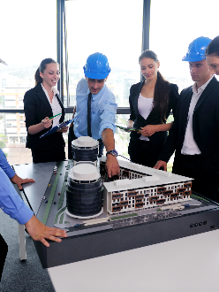
Employee Onboarding
Effective employee onboarding serves three interrelated purposes: First, it ensures that the employees feel welcome, comfortable, prepared, and supported. Second, these feelings increase the new employees’ ability to make an impact (be productive) within their role, both immediately and over time. Finally, this employee success leads to satisfaction and retention, which allows the Agency to continue to meet its mission.
How are we doing?
New Employee Welcome (NEW): Revamped format to provide new employees with information, connections and resources to increase their success and retention.
Statewide Onboarding Initiative: Includes adaptation of Workplace Civility and Unconscious Bias as one of two mandatory in-class trainings for all SOV employees.
What are we doing to improve?
Implementation of Agency-wide bi-weekly progress meetings for all Agency probationary employees and temps/ interns.
Cohort Building: Mold new employees that begin at similar times to support one another as they grow, move and establish themselves in our workforce.
33

Slide 34
Competencies
Competencies are observable abilities, skills, knowledge, motivations or traits defined in terms of the behaviors needed for successful job performance. They are aptitudes or knowledge, whether underlying or observable, that allow a person to succeed in the development of a particular activity.
How are we doing?
Use of Korn Ferry tools.
Competency mapping has been completed for all Maintenance and Operations Garage positions.
What are we doing to improve?
Learning Opportunities: Mapping based off Job-Development Plans for all Agency positions.
Job spec update/ mins update: Review of positions that are currently going through the decentralized reallocation process to create a guide and determine an Agency-wide process.
34

Slide 35
Learning & Development
Training, which is defined as a planned effort to ease the gathering of job-related knowledge, skills, and behavior, was found to be connected to the amount of retained employees and workforce productivity.
How are we doing?
The Employee Development Branch builds leadership, supervisory, communication, career development and other interpersonal skills.
The Technical and DMV branches provide role-specific training to improve job performance, create efficiencies and invest in future skills.
The Health and Safety Branch provides safety training to ensure OSHA compliance, worker safety, and workplace hazards prevention and awareness.
What are we doing to improve?
Continuing to improve current and expand future training offerings
Increased communications via eNewsletters, Lunch & Learn programs and more micro-learning-based tools.
35

Slide 36
Managers & Supervisors
Managers and supervisors have the most consistent impact on employee engagement, morale, and productivity. They have a large influence over team culture, they lead performance managements, and they are responsible for individual development of their staff. “People don’t leave companies, they leave supervisors”
How are we doing?
Pre-supervisory training (Pathway to Supervision) offered, to educate employees about the roles and responsibilities.
Mandatory New Supervisor Welcome training.
Strategic Workforce Committees for the developing tools and resources
What are we doing to improve?
Mandated Supervisory Training will continue to be offered and tracked to ensure compliance.
eNewsletter targeted to supervisors, to share pertinent information in multiple platforms.
Manager & Supervisor online Toolkit
36

Slide 37
Knowledge Management
With the increased access to mountains of data comes the increased priority on how to manage the knowledge of our Agency. When considering high retirement rates (27.6% by 2022) and the general mobility of our workforce, knowledge management becomes even more important.
How are we doing?
Immediate knowledge transfer: Knowledge Transfer Plan has been provided to assist with gathering knowledge from a departing employee.
UVM Study: resulted in a form and process to capture and share knowledge, a place for storing that knowledge and a system for searching documents produced.
What are we doing to improve?
Policies & Procedures: Need to be updated and stored in a consistent location.
Knowledge Management Task Force: Need to be created and representative of Agency wide participation. Will catalogue and prioritize and provide support to initiatives.
37

Slide 38
Employee Retention
Employee retention is the policies and practices of a company, an ability of organizations, and a strategic process in which employees are convinced to stay.
How are we doing?
Training: safety, technical, employee development and DMV training provided, and continuously growing agency specific options.
Teams: having personal attachments within teams increases the employees’ performance and decreased their intent to leave.
What are we doing to improve?
Recognition/ Appreciation: Will be included on the new VTTC homepage; increases visual of appreciation to current and perspective AOT employees.
Decentralized Reallocation: meant to provide fair and equitable classification to employees as well as recruiting and growth opportunities within the Agency.
Dedicated plan for retirement wave: there is an impending retirement wave in the coming years based on current data; by having a strategy in place, we decrease the risk of high turnover.
38

Slide 39
Employee Offboarding
Appropriate offboarding is a critical talent management activity for a variety of reasons; some employees will return to work for the State or for the Agency again. Leaving in a positive environment encourages employee reintroduction at a later time.
How are we doing?
Exit Interviews: Obtaining information from departing employees can help give our strategies direction and valuable insight. The exit interview questionnaire identifies, from the employee’s perspective what is going well and what gaps existed in their work environment.
What are we doing to improve?
Communication improvements for exit interviews: more will be sent to managers and supervisors to remind them to notify DHR in advance of their employee’s departure.
Knowledge Transfer: develop a more formal process for when an employee is departing, so that knowledge is not lost, but retained.
39

Slide 40
Strategic Workforce Committee Process, Year 1
Secured Agreement with Exec Staff
Application sent to all employees- 1st and 2nd choice committees
Established Committee Chairs and Sponsors
Negotiated with leaders for employee participation
Launched committees
Notes:
Over 100 employees applied

Slide 41
Strategic Workforce Plan & Committees Year 1
Approved & Implemented in Early 2019
Eight SWF Committees Constituted in Summer 2019:
Managers & Supervisors
Learning & Development
Employee Engagement
Customer Service
Employee Retention & Quality of Life
Civility & Respect
Onboarding
Outreach, Recruitment & Hiring
41

Slide 42
Strategic Workforce Plan & Committees Year 1 Outcomes
Performance language to be included in every Supervisor's annual evaluation
VTTC launched individualized coaching services
Strategic plan posters and talking points for managers
Updated Individual Developments Plan document
Employee recognition website ready to launch
Updated SharePoint site to boost agencywide collaboration
In person and online customized customer service training
Senior leader podcast
Launched Manager & Supervisor Toolkit website and lunch & learns
42

Slide 43
Strategic Workforce Plan & Committees Lessons Learned
Need more communication
More advisors vs. workers
Overlap of topics
Clearer definition of roles and accountability for deliverables
Setting Deliverable timelines and opportunities to present to the Leadership Team (Exec Staff)
43

Slide 44
Strategic Workforce Committee Process, Year 2
Merged committees that had similar project ideas – from 8 committees to 4
New applications sent to all agency employees, including those that participated, giving those employees a chance to extract from participating or move to a different committee
Established Committee Chairs and Sponsors
Negotiated with leaders for employee participation
Launched committees

Slide 45
Strategic Workforce Plan & Committees Year 2
Fall 2020 Eight Committees Streamlined into Four Committees
Managers & Supervisors
Learning & Development
Engagement and Retention
Talent Acquisition & Onboarding Committee Meeting
Customer Service and Civility & Respect embedded in each Committee
45

Slide 46
Other Modern Workforce Initiatives
Telecommuting policy
Infant in the workplace
Civility Commitment and mandated unconscious bias training
Expansion of Microsoft Teams
Open workspace environment
Annual employee engagement survey

Slide 47
Leadership Architecture
Expansion of the use of Korn Ferry Leadership Architecture
Currently used in more than 50% of hires at a supervisor or higher level
Two staff members became certified in Korn Ferry Leadership Architecture
Align competencies at a statewide level
Partner with Human Resources, Agency of Human Services, Department of Public Safety

Slide 48
VTrans Training Center Programs

Slide 49
In This Section
Employee Development Priorities
Learning and Development Team & Programs
Safety and Health Team & Programs
Technical Development Team & Programs
Vermont Local Roads Team & Programs

Slide 50
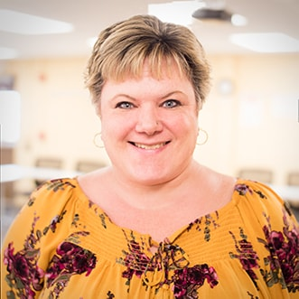
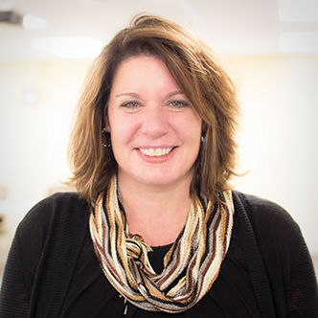
Learning & Development: Our Team
Colleen Montague
Tammy Johnson
Gretchen King
Sari Tiersch
Learning Development & Support Manager
Colleen.Montague@vermont.gov
Scheduling/ Admin. Services Coordinator
Tammy.Johnson@vermont.gov
LMS Administrator/ Admin. Services
Coordinator
Gretchen.King@vermont.gov
Organizational Development
Coordinator
Sari.Tiersch@vermont.gov
50

Slide 51
New Employee Welcome (N.E.W.)
New Employee Welcome Goes Virtual
Month | Activity
Month 1 | One on One - building rapport and issue spotting
Month 2 | Group, Ouch!, Respect, Learning Management System, Resources, Human Resources
Month 3 | One on One
Month 4 | Group - Customer Service & Safety
Month 5 | One on Two with supervisor and employee – Individual Development Plans introducing formal mentoring
Month 6 | Group activity - Other resource ambassadors and Executive Team
Notes:
One on One sessions are 45-60 minutes, there is also a checklist of conversation topics
Cohort sessions months 2,4,6 are 1.5-2 hours

Slide 52
N.E.W. Road Map
New Employee Orientation
Standardized Training Courses
Professional Development Pathways
Key Communication Points for Managers to Check In with Their New Hires
Onboarding Guide & Toolkit on DHR’s Website

Slide 53
N.E.W. Benefits and Outcomes
Retention – Build Trust and Alignment
Identify Role Models & Resource Ambassadors
Connect New Employees to Leaders & Managers
Remove Silos and Encourage Networking
Introduce/Reinforce Our Strategic Goals & Culture
Provide Expectations, Ouch Training, PASH & Tools for Success

Slide 54
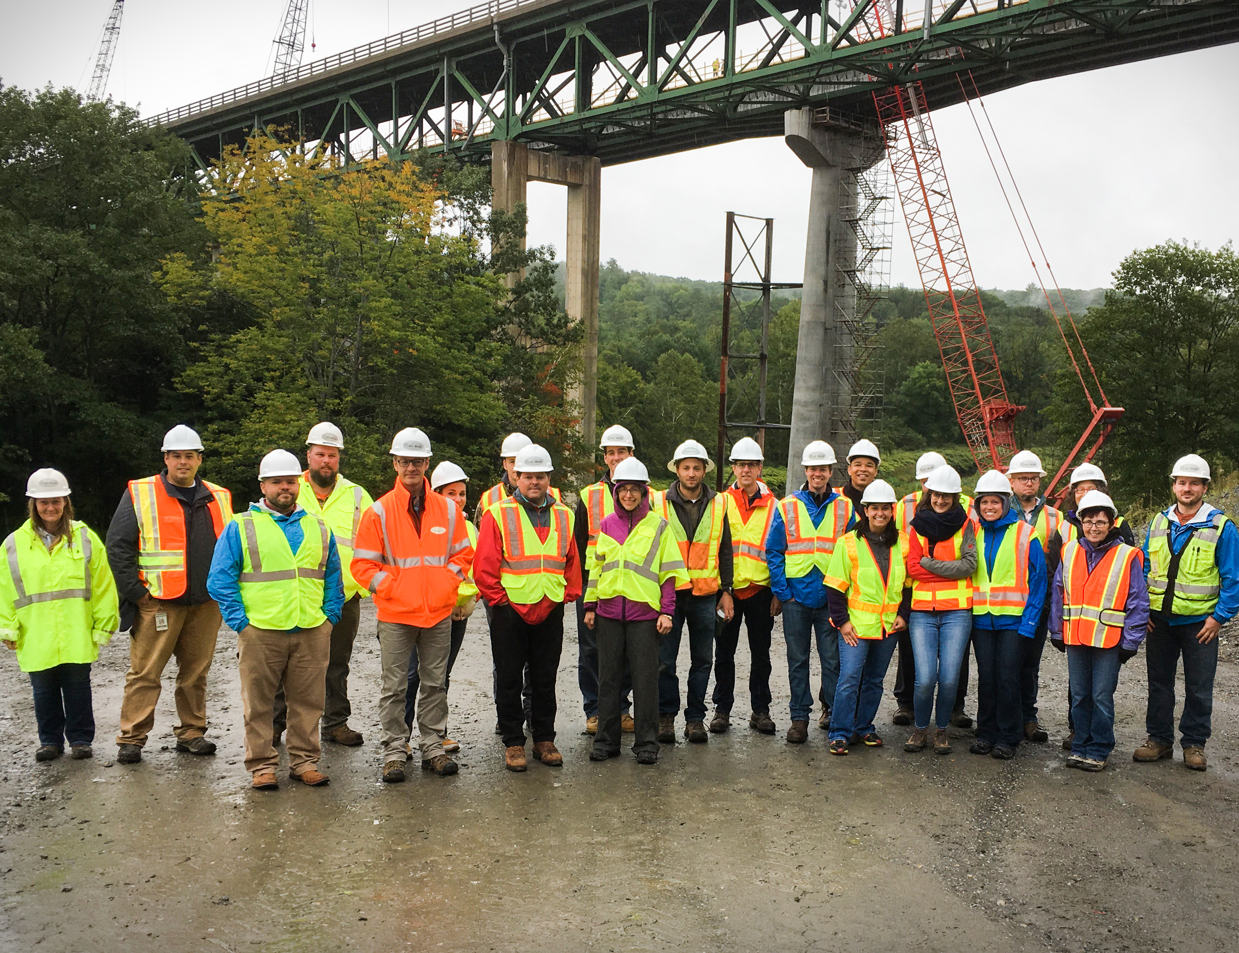
Transportation Leadership Institute
Program for Emerging Leaders
Participation from all areas of the Agency
Thirteen-month program, starting in July – Graduates welcome next cohort
Uses a 70:20:10 Model for Learning and Development
Using a blended learning style: classroom setting, self-study, mentoring, workdays, and participant lead lunch and learns
Participants paired with a mentor from Leadership team
54

Slide 55
Pathway to Supervision
Five-day course on fundamentals of supervisory responsibilities.
Supervisory roles and expectations and the importance of being a role model
Using strength-based assessments
Large percentage of promotion or career advancement
Initially planned for 3-4 times per year, high demand and often a waiting list for each session
55

Slide 56
Supervising in State Government
Provided by our partners at the DHR Training Center.
Mandatory statewide 4-day training for all new supervisors.
Focuses on the skills a supervisor needs to survive and thrive in state service.
Fosters a strength-based approach to supervision.
Enhancing employee engagement across state government.

Slide 57
Change Management
Understand how change affects various aspects of our work and lives
Gain insight into the organizational impact of change and its effect on individuals
Understand the relationship between productivity and effort during change
Understand broad strategies to support employees through a change initiative
Understand the benefits of developing personal accountability and adaptability as a “way of being”
57

Slide 58
Biz Library
Employees now have access to over 8000 eLearning modules
Easy to search with keywords
Just in time learning
Supports individualized learning and career development plans
Modules can be combined to create playlists
Supports virtual learning goals and needs
58

Slide 59
Strength Based Team Retreats
Studies show when we focus on developing our strengths, we grow faster than when trying to improve our weaknesses
People invest in their strengths are:
Three times as likely to report having an excellent quality of life
Six times as likely to be engage in their jobs
Team centric work to create appreciation and awareness of individual and team strengths
Diversity of perspectives
Strengths can support and balance each other, creating stronger team dynamics and productivity
59

Slide 60
Strengths Grid
60

Slide 61
Mentoring Program
The delicate balance of mentoring someone is not creating them in your own image but giving them the opportunity to create themselves. ~Steven Spielberg
Multitude of benefits
For the Organization
Reinforce a positive organizational culture
Opportunities to shape the workforce of the future in an intentional, deliberate way to meet strategic goals and objectives
Increased morale of participating employees
Helps to eliminate silos
Sharing institutional knowledge
For the Mentor
Exposure to new ideas, technologies and perspectives
Personal satisfaction in assisting others
Facilitate growth by providing resources and contacts.
An opportunity to “recharge their battery”
A catalyst to spark activity and fulfillment for the mid-career professional
For the Mentee
Personal and professional
A safe learning environment to expand horizons
Exposure to new ideas, technologies and perspectives through the relationship with the mentor.
Gain knowledge and skills in the organization structure, processes, policies and procedures, culture, and work environments
New technical, interpersonal and/or leadership skills
Improved self-confidence

Slide 62
Rotational Engineer Program
Highway Division Program to expose new employees within the Civil Engineer positions to a variety of division, bureaus, sections, and units within VTrans. Initial rotation is a 6-month placement, after that time placements can vary from 3 - 6 months.
2 dedicated positions
3 Year rotation – initially within the engineer field
Career development and retention strategy
Builds skills, knowledge and competencies
Reduces silos and builds relationships
Future Trends
Broader participation
Formal job shadowing

Slide 63
Decentralized Reallocation
Creates a career path
Piloted at AOT for AOT owned job series
Clear expectations of competencies at different levels in a job series
Creates a promotion process without going through a lengthier classification process
Empowers employees to take control of their rate of promotion
Need to expand to statewide job series

Slide 64
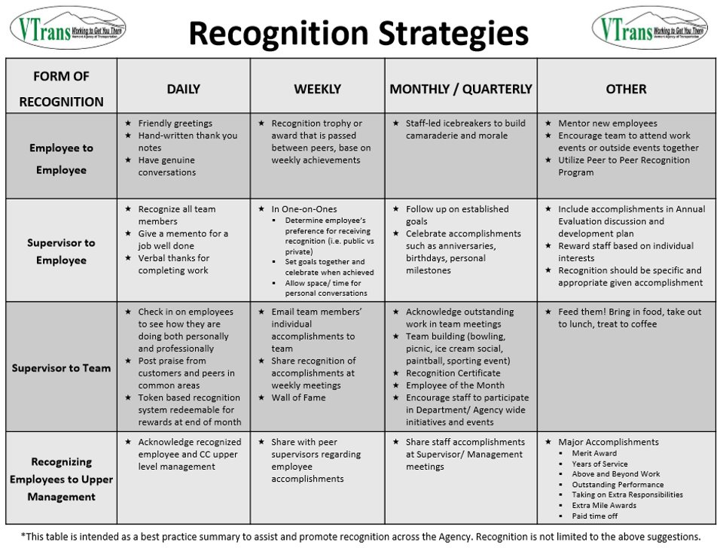
Employee Recognition
Our TLI cohort took this on as a project and developed strategies around different recognition types
It was then taken over for a brief time by our Employee Engagement Workforce committee.
Next steps include rolling out these recognition strategies to supervisors and Agency wide to increase engagement, especially in this ‘distributed work’ environment.
64

Slide 65
Succession Planning
Informal process.
We have an open and competitive bargained recruitment process.
Building a knowledge management (KM) culture.
Programming and retention strategies specifically for emerging leaders.
Teaching KM to emerging leaders.
Mentoring and job shadow opportunities.
Provide stretch projects and individual development plans.
Notes:
DONE

Slide 66
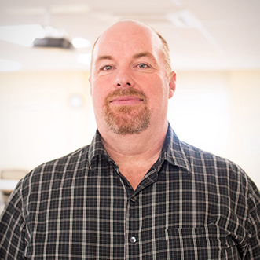
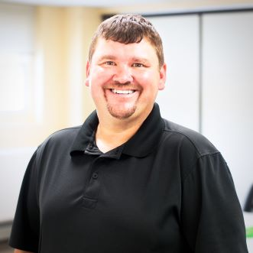
Safety & Health: Our Team
Rob Gentle
Carl Senecal
Liz Beebe
Mike Labounty
Kyle Record
Safety Officer
Rob.Gentle@vermont.gov
Deputy Safety Officer
Carl.Senecal@vermont.gov
NW Occupational Safety Technician
Liz.Beebe@vermont.gov
NE Occupational Safety Technician
Michael.Labounty@vermont.gov
SW Occupational Safety Technician
Kyle.Record@vermont.gov

Slide 67
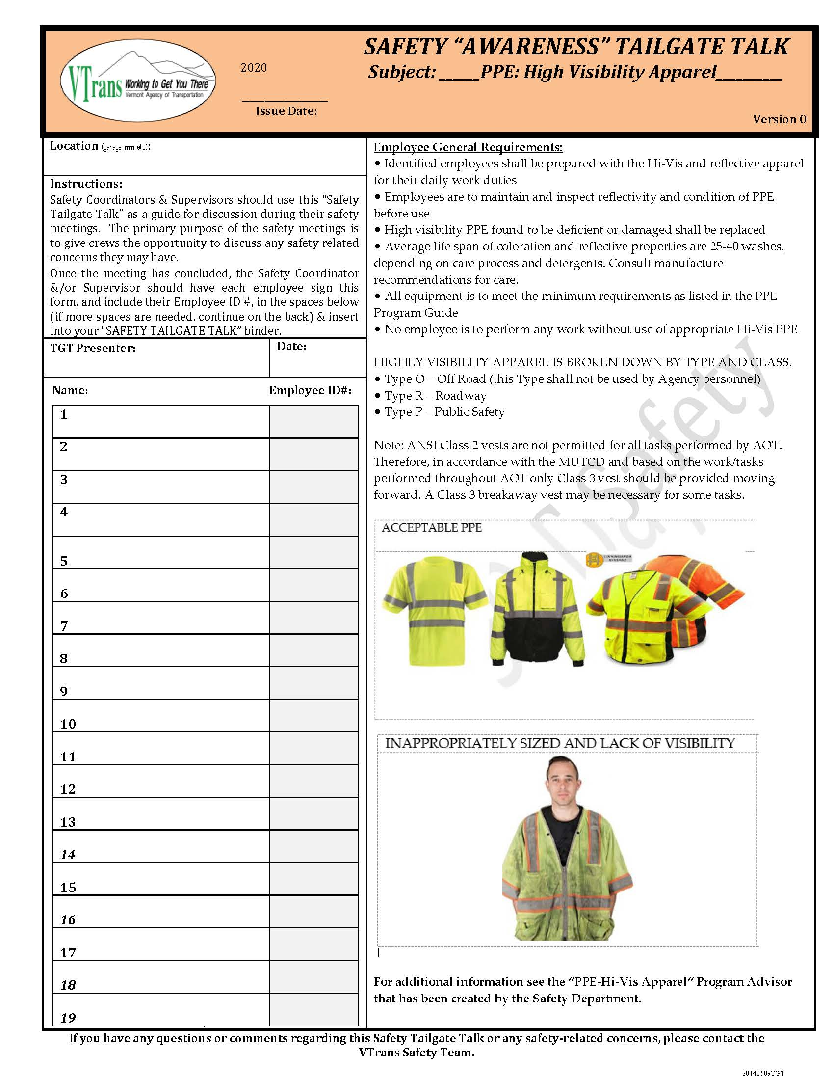
Supporting Behavioral Based Safety
Behavioral Based Safety (BBS) is built on employee & management commitment, accountability, involvement, hazard ID and control, Incident/accident analysis, training and program evaluation.
Identification and correction of these deficiencies are improved as a result of the creation and implementation of innovative tools and resources.
Facility Discrepancy Reports, serving as a monthly evaluation of conditions and possible needs to ensure safety and compliance.
The facility improvement process works twofold, as it not only improves workplace safety, it also helps strengthen the notion that the Safety Team(s) and the Agency are partnered to improve work conditions, and their participation is a critical step.
Ensuring employees have the knowledge and tools necessary to identify, communicate, and control hazards.
Building curriculum using both in person trainings and the Learning Management System (LMS) has created education opportunities for targeted courses that are easily accessible for all of our customers. Such as Employee New
Development of “Program Advisors”: a catalog of task/hazard specific resources, detailing Agency best practices, hazard identification and mitigation, and training requirements.
Bi-weekly one-page, concise “Tailgate Talks” are distributed providing Safety Awareness information on a schedule targeted to ensure topics relevance. Completion of these short trainings/discussions are tracked within the LMS system.

Slide 68
COVID-19 Safety Initiatives
Creation of a Workforce Safety Plan as required by the Agency of Commerce and Community Development (ACCD) with frequent updates and guidance.
Bi-weekly Question and Answer (Q & A) sessions and document for Agency COVID Health Officers and leaders
Develop COVID specific trainings and coordinate voice over and upload to the Learning Management System (LMS) such as Health Officer Training and Safety Plans
Perform evaluations at a variety of Agency sites to provide solutions for COVID related health, safety, and compliance issues to include maintenance garages, construction sites, car counting sites, and Department of Motor Vehicle locations.

Slide 69
Technical Development: Our Team
JoAnn Stevens
Sara Williams
DMV Branch Manager
Joann.Stevens@vermont.gov
Sara Williams
Sara.Williams@vermont.gov

Slide 70
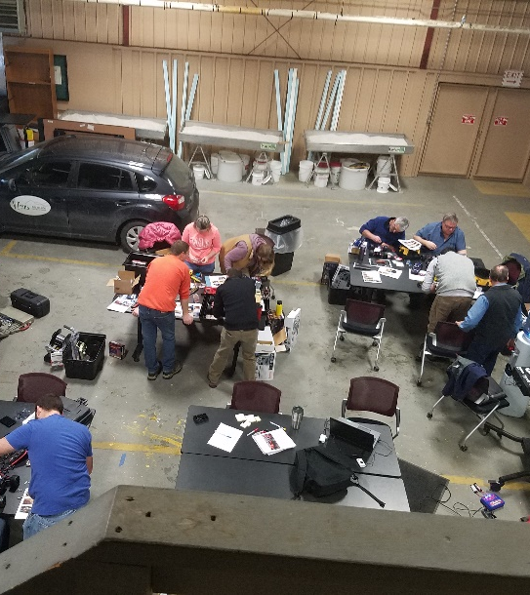
Technical Development
274 TC3 courses completed last fiscal year 7/1/19-6/30/20.
Rescheduled upcoming NHI (National Highway Institute) course “Modern Roundabouts: Designed for Safety” to a virtual delivery; rescheduled all other NHI trainings that were slated for 2020 to 2021.
Transitioning annual Winter Maintenance and Work Zone/Flagger training to virtual delivery.
Developed COVID specific training requirements for mission critical, in-person trainings.
Working with SMEs to create a scope of work for a virtual GIS course.
Collaborated with ANR to expand the scope of work and reinstate the Rivers and Roads Tier III contract to provide another round of train the trainer courses.
Assisting the Maintenance Bureau with CDL support both in-house volunteers and new hires (coordinating efforts regarding training and testing).

Slide 71
DMV Development
Projected 2020 Goals:
Customer Service and Mandated Training Rollout
Time with CVO/FAST project 80% of schedule
Testing System functionality
Presenting topics during Lunch and Learn sessions
Developing Training documentation and scheduling/logistics
Conducting Training for DMV Units: Commercial Vehicle Operations, Accounts Receivable, Audit, and Tiger Team
20% of time spent on identifying and developing training plans and logistical needs for DMV
Registration eLearning
2 to 5-Year Plan:
Serve as Training Coordinator for Legislative and Culturally Mandated training
Collaborate with Civil Rights on Confidentiality Training and mandated legislative/settlement training and perform auditing role for monitoring compliance
Deliver Customer Service Training
Create process for DMV Unit and Branch supervisors to submit New Employee Training Checklist for OJT (on-the-job) training credit and capture in Learning Management System
Additional phases of VTPICS (credentialing system) and CVO/FAST (Commercial Vehicle System) Project Training
Reconfiguration of DMV Training Room – Agency asset
Strategic Workforce – job specific assigned training
Examiner Certification

Slide 72
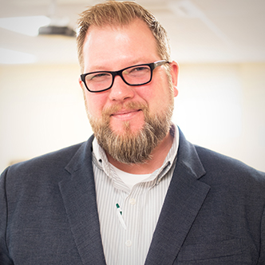
Vermont Local Roads: Our Team
Stuart Johnson
Todd Eaton
Holly Hayden
Branch Manager
Stu.Johnson@vermont.gov
Technical Assistance & Training Specialist
Todd.Eaton@vermont.gov
Program Coordinator
Holly.Hayden@vermont.gov

Slide 73
Vermont Local Roads; Municipal Support
Purpose: Vermont Local Roads (VLR) is Vermont’s Local Technical Assistance Program (LTAP) sponsored by the Federal Highway Administration (FHWA)and the Vermont Agency of Transportation (AOT).
Mission: To foster a safe, efficient, and environmentally sound surface transportation system by improving skills and increasing knowledge of the transportation workforce and decision makers.
Listserv: A Listserv is a method of communicating with a group of people via email. You send one email message to the “reflector” email address, and the software sends the email to all the group's subscribers.
Learning Management System: A learning management system, (LMS) is a software that is designed specifically to create, distribute, and manage the delivery of educational content.
Roads Scholar Program: Environmental, Equipment, Safety, Supervisory & Technical
TC3 online classes: LTAPA signed agreement with AASHTO to prepay online class usage for all LTAP Centers.

Slide 74
This affiliation allows VLR access to:
VLR utilizes Subject Matter Experts within VTrans and other state agencies to deliver training
VLR coordinates with the VTrans Technical Center Safety and Technical Branches for combined training opportunities that are provided to municipal customers and VTrans employees
VLR collaborates with other VTTC branches to create and utilize contracts, this ensures that redundancy is limited
VLR provides digital, technical, material, and administrative support systems to municipal
VLR provides ongoing opportunities for staff for personal development

Slide 75
VTTC Tools

Slide 76
In This Section
Training Report
Kirkpatrick Evaluation
Technology Investments

Slide 77
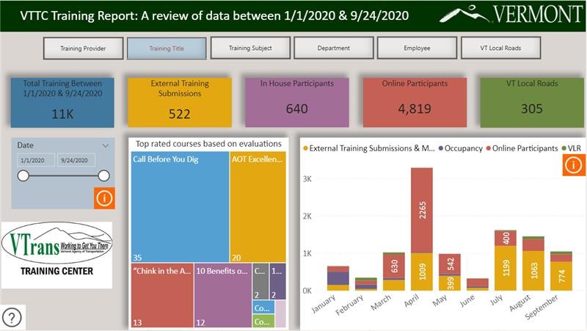

Slide 78
Kirkpatrick Evaluation Level 1-4
The main purpose of evaluating a training program is to gain knowledge about whether it has achieved or failed its objectives. Analyzing training events by using appropriate evaluation tools can improve the outcome of future trainings
Reaction
Behavior
Results
Learning
acquire the intended knowledge, skills, attitude, confidence and commitment
acquire the intended knowledge, skills, attitude, confidence and commitment based on their participation in the training
apply what they learned during the training when they are back on the job
targeted outcomes occur as a result of the training and the support and accountability package

Slide 79
Technology Investments
Constant Contact – 2006
Statewide Implementation of a Learning Management System – 2006
TC3 AASHTO Technical Classes – 2009
KnowledgeWave – 2008
Biz Library – 2020
Microsoft Teams – 2020
Virtual Learning Platform –
Coming soon

Slide 80
COVID-19 The Change Accelerator
This Photo by Unknown Author is licensed under CC BY-NC-ND

Slide 81
In This Section
Online Learning Consumption
COVID Response
Government Operations
Future Initiatives

Slide 82
AOT Online Learning Consumption
350% growth rate in online learning
eLearning is an efficiency gain since online learning takes 40% - 60% less time to complete compared to traditional learning while increasing information retention by 25% - 60% (Chernev, 2020)
Mandated Statewide onboarding requirements
Occupational health and safety content from workers compensation provider
Statewide collaboration to implement Biz Library contract for 5,000+ eLearning titles
AASHTO TC3 Online technical classes
Mandated technology/security coursework
Mandated COVID related safety training
Chernev, B. (2020). 27 Astonishing E-learning Statistics for 2020. Techjury. [Website]. Retrieved from https://techjury.net/blog/elearning-statistics/#gref
82

Slide 83
AOT Positions for COVID-19
COVID-19 Pandemic maximized existing efforts to modernize. What may have taken years took months.
A large number of AOT employees telecommute at least a part of the week.
Adopted flexible work schedules.
Supported parents with childcare and education needs with leave options.
Created an availability tracker and managed dozens of mission critical assignments to other Agencies. Car counting, food distribution, mask distribution, Department of Health, Labor, DMV
All groups utilize Microsoft Teams or other communication tools.
Investment in OneDrive and file sharing positions us to succeed in crises.
Learning Management System already being utilized to manage training records and online learning.
Recently researched 22 other states; we were on target or leading innovations.

Slide 84
Transportation Incident Command Center

Slide 85
Pandemic Objectives
Mitigate
Mitigate Employee Absence
Develop agency comms plan
Enhance facility disinfecting
Direct remote work options
Direct shift work options
Limit travel
Limit meetings
Direct telecons
Direct fleet/equipment sanitization
Sustain
Sustain Mission Essential Functions
Disseminate & review MEFs
Provide planning assumptions
Assess against:
Identify Primary/Secondary leads
Assist
Assist with State-level Containment and Mitigation
Augment National Guard in cordon & quarantine
DMV Law Enforcement assist locals & State Police
VMS messaging
Direct ops changes to public transit, air & maritime
Assess public facing protocols

Slide 86
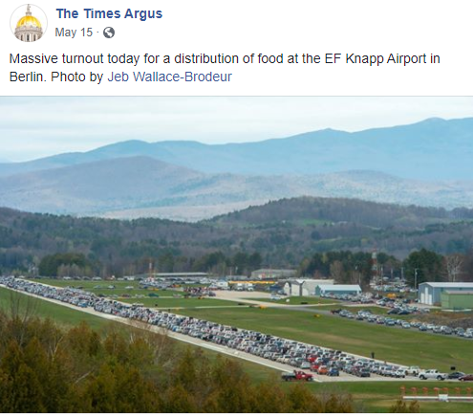
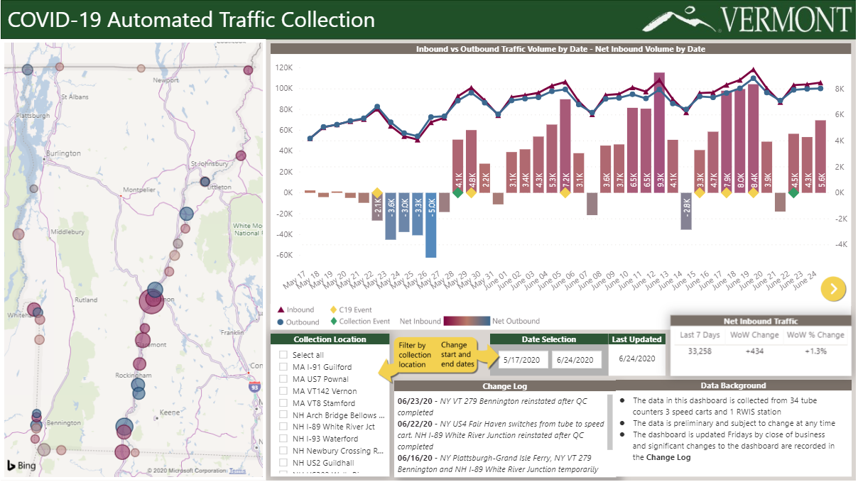
Key Missions
Community Points of Distribution
Traffic monitoring
86

Slide 87
Examples of Specific Actions
Examples of Specific Actions
Transitioned ~500 employees to telework within 72 hours
Facilitated order and distribution of over 500 mobile devices to increase employee productivity
Developed a staff availability application
Developing a state asset tracker (Computers, monitors, printers, etc.)
Supported food distribution sites throughout Vermont
Supporting flu clinics throughout the state
Deployed 60-70 AOT/DMV staff to other Agencies and Departments to assist
Supporting the distribution of PPE supplies throughout the state
Developed and support of AOT/DMV safety liaisons
Support with supply procurement
Developed procedures for access to closed facilities
Support safety visits to offices and field-based operations

Slide 88
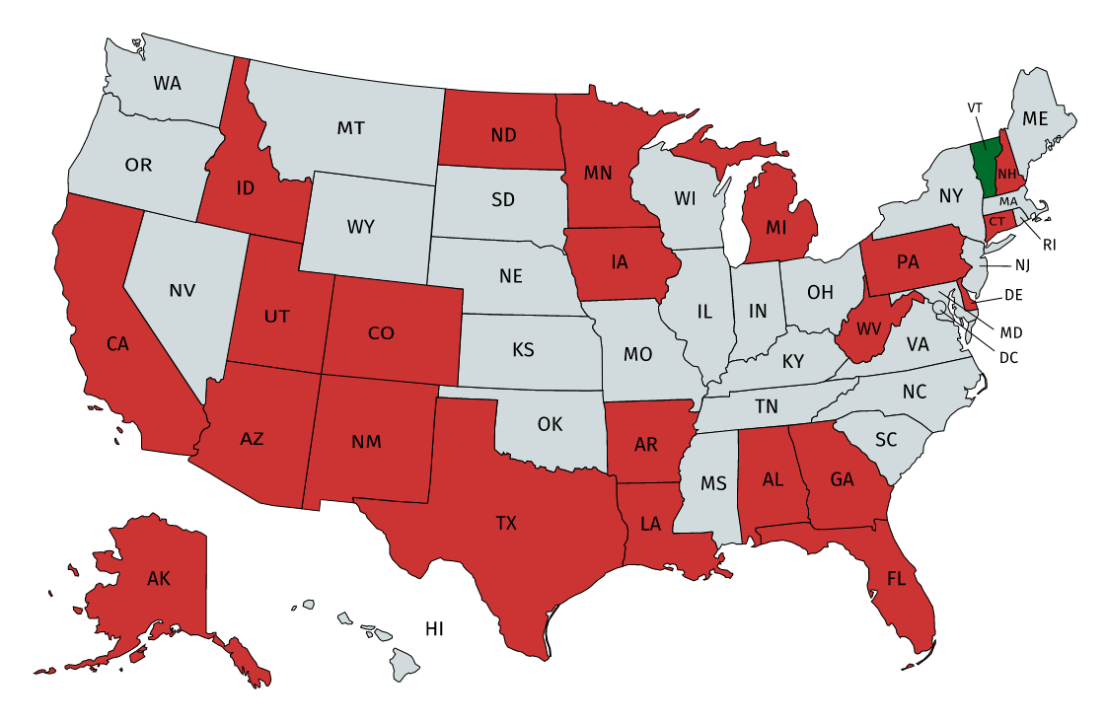
Peer Outreach for Best Practices
Power of Networks and Collaboration
Request for Best Practices and Innovation in Workforce in response to COVID
Short turnaround time needed
21 States + FHWA Responded
88

Slide 89
Government Operations New Workforce, New Workplace
Benefits: Analysis showed changes to benefits were necessary to satisfy current employee needs, and attract future employees, such as cafeteria style benefits packages.
Employee/Leadership Development: Employees are given equitable access to resources, opportunities and experiences that will develop careers paths and support industry specific subject matter experts and emerging leaders, resulting in employee retention and fostering succession planning across state government.
Social Justice Diversity & Inclusion: To develop a culture of inclusion where all employees have a sense of belonging, feel respected, empowered, and have clear opportunities for advancement.
Telework: Employees have what they need to feel effective, satisfied, and supported in working from home, and quality of life and work improves as a result. Simultaneously, customers will experience improved services.
Workforce: To identify, assess, and recommend short-term and long-term strategic workforce strategies for implementation consideration based upon best practices and research

Slide 90
Government Operations Telework Initiative Example Activities
Develop an updated telework policy while ensuring equitability
Understand workers’ comp. liability and confidentiality standards
Develop trauma-informed supervision
Define alternate work locations due to poor bandwidth
Promote training for remote work efficiency
Promote training for remote leadership
Remote performance management
Create worksheet to determine position eligibility
Educate about flexible work hour options that aligns with bargaining agreement

Slide 91
Government Operations Example Initiatives to Analyze
Maximize career growth path
Strengthen employee and leader engagement
Review current job descriptions
Evaluate health insurance deductible geared toward younger generation with student loan assistance
Establish regular equity review practices
Modernize interview practices, consider blind resume reviews
Classification system revamp – will testify this legislative session
Shared learning and development goals
Align competencies across Agencies

Slide 92
Questions?
92

